Slide 1





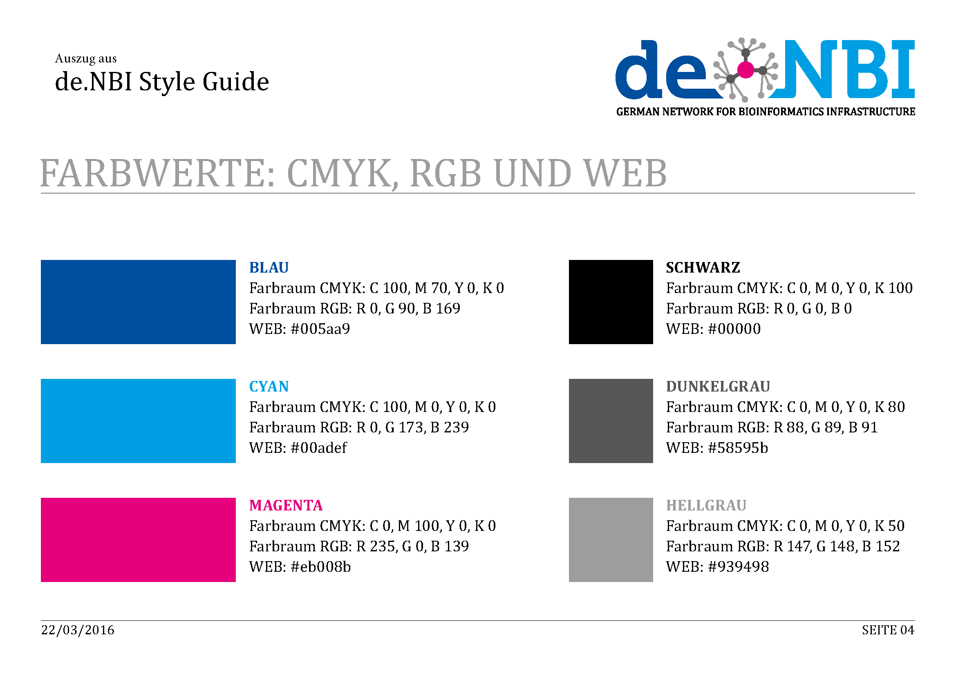
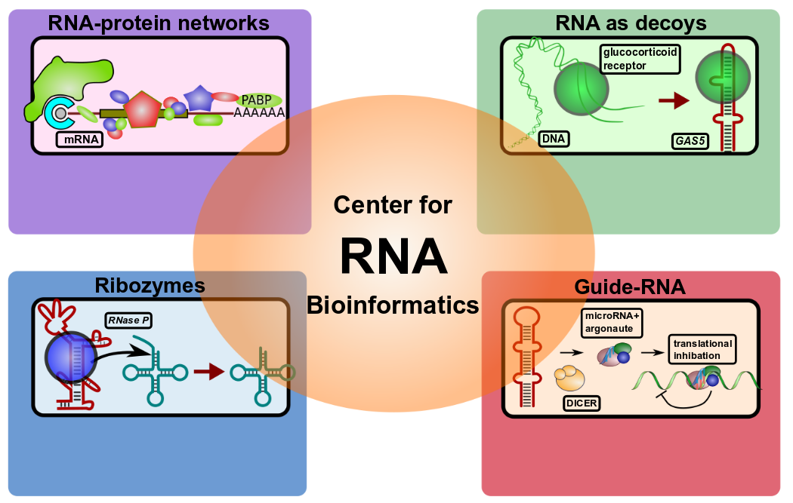
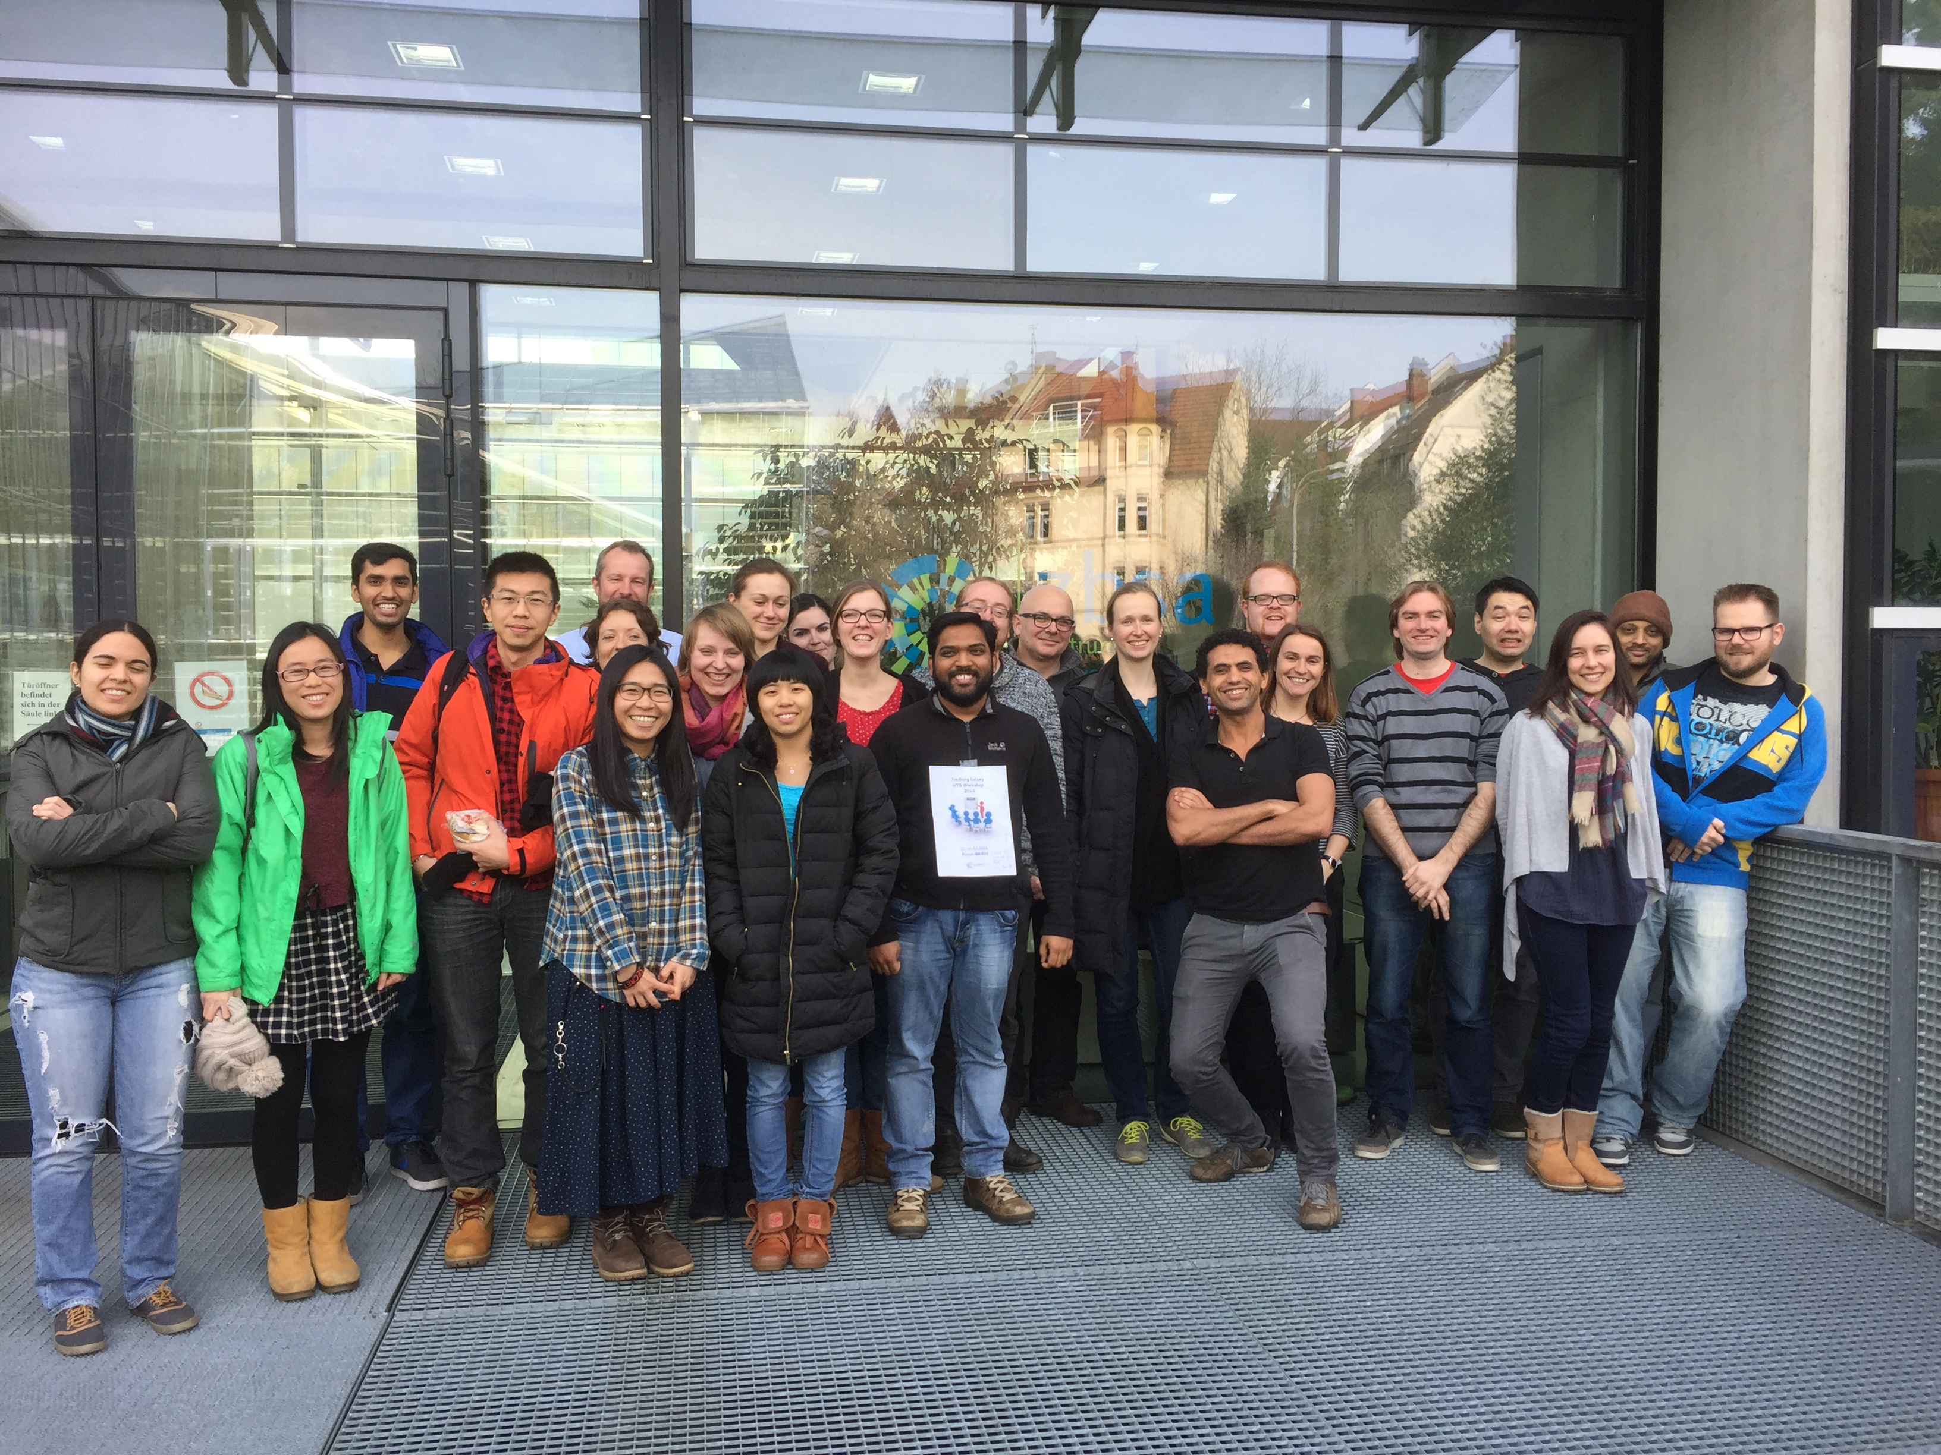
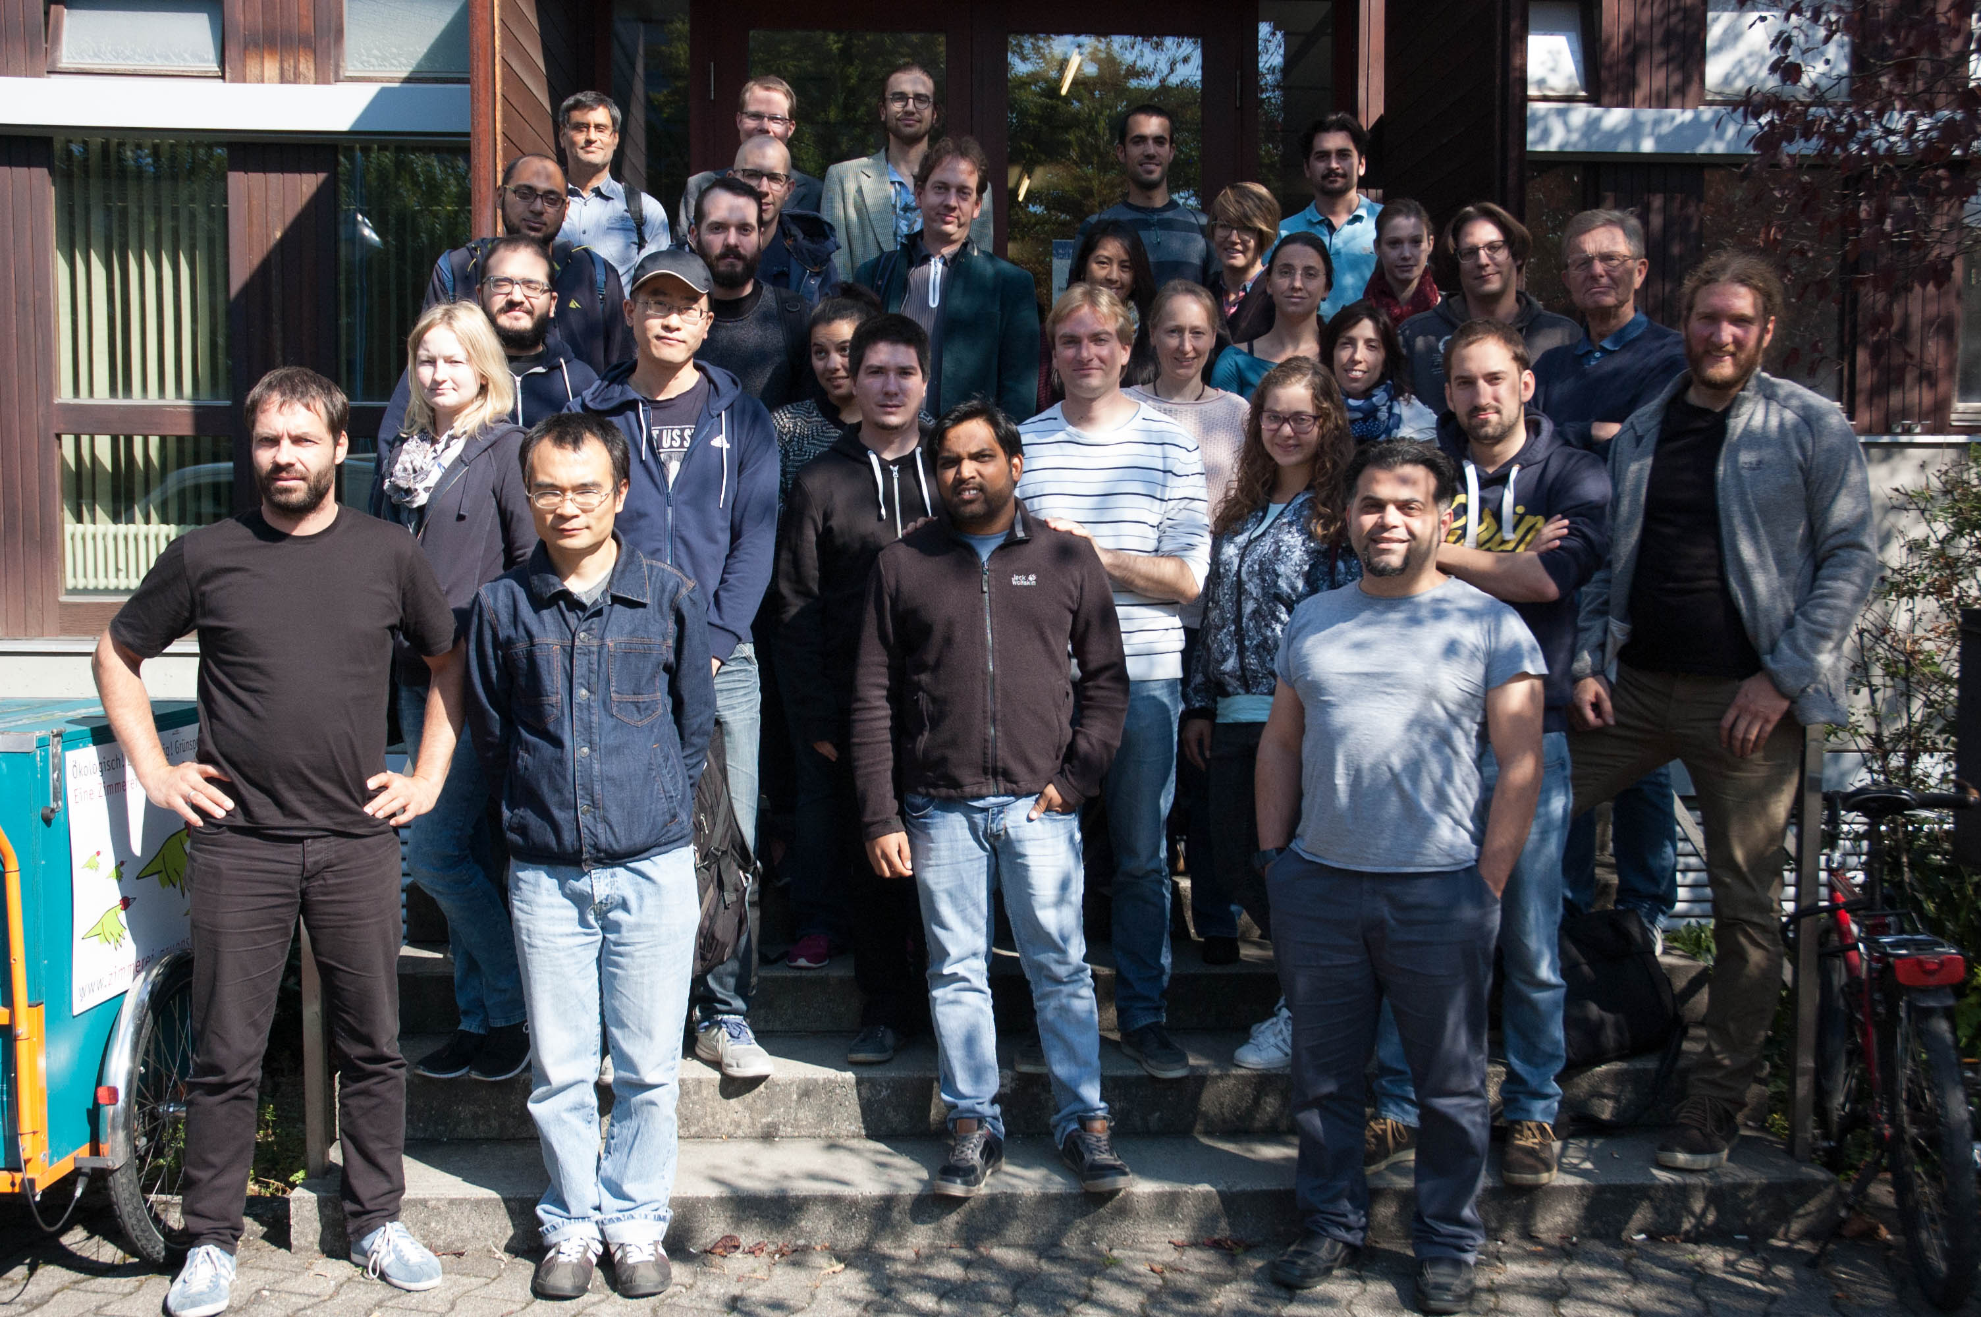




de.NBI − German Network for Bioinformatics Infrastructure
RBC
RNA Bioinformatics Center
University of Freiburg
Chair of Prof. Rolf Backofen
Rolf Backofen, Bérénice Batut, Anika Erxleben, Björn Grüning, Torsten Houwaart, Joachim Wolff
RNA Bioinformatics Center, University of Freiburg, Germany
Short description of the project
de.NBI services
Hinweis:
The RBC at the University of Freiburg offers tools, services and training for the analysis of RNA-RNA interactions and
RNA-protein interactions
Galaxy server http://galaxy.uni-freiburg.de
available for all german research facilities in 2017
de.NBI cloud
making software available through bioconda
Freiburg RNA tools webserver
http://rna.informatik.uni-freiburg.de/
Analysis platform in a box
RNA toolbox
- analysis of CLIPseq data
- detection of RNA motifs
- RNA-protein interactions
- RNA structure prediction
- detection of ncRNAs
- RNA structure prediction
- RNA conserveration
- ncRNA target prediction
- miRNA/ncRNA detection
Progress report
de. NBI training and education
Continued evaluation of tools for RNA-RNA RNA-protein interactions
- eCLIP pipeline ?
Definition of SOP for RNA seq
Training stuff
HTS data analysis workshop
twice per year
Since 2013 -> 7 Galaxy workshops on HTS data analysis with each ~30 participants -> 225 participants
1 genome annotation workshop in 2015 -> 12 participants
Training material available at github.com/bgruening/training-material
Publications
(If applicable)
HTS/Galaxy workshop
Feb 22-26 2016
HTS/Galaxy workshop
Sep 19-23 2016
Förderkennzeichen Nr…..
http://www.denbi.de

